Slide 2
Inventive Programming by TRIZ
Aleksandr Kugushev

Slide 3
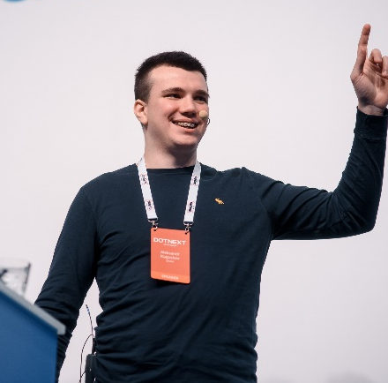
About Me
#TBD
#TBD
Aleksandr Kugushev
EPAM SYSTEMS,
LEAD SOFTWARE ENGINEER

Slide 4
Disclaimer
Not an introduction to TRIZ
Not required to know TRIZ
Pragmatic approach
Notes:
1. You will find resources at the end of the presentation
2. It’s not necessary to know the theory of category to get benefits from monads
3. Difficult problems require an inventive solution, and TRIZ provides a range of strategies and tools for finding these inventive solutions. We’ll focus just on a few techniques that are extremely helpful for programmers,

Slide 5


Software Development
Expectation
Reality
Construct applications by combining building blocks
Solving inventive problems

Slide 6

What is an inventive problem?
Notes:
It is like solving puzzle

Slide 7
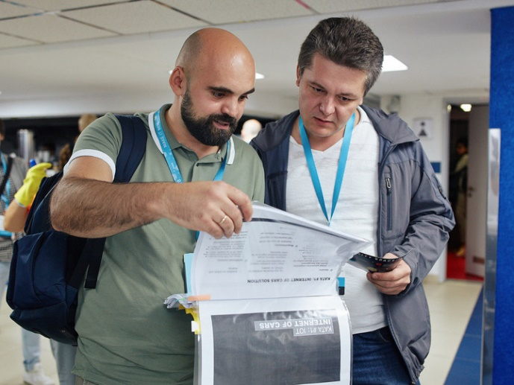

How to solve an inventive problem?
Read a manual
Get a Tip
Ready-Made Solutions
Reference Architecture
TRIZ
Notes:
1. But usually, we can’t find an appropriate pattern or ready-made solution.
2. You still require thinking, but it gives you a directions to appropriate solution

Slide 8
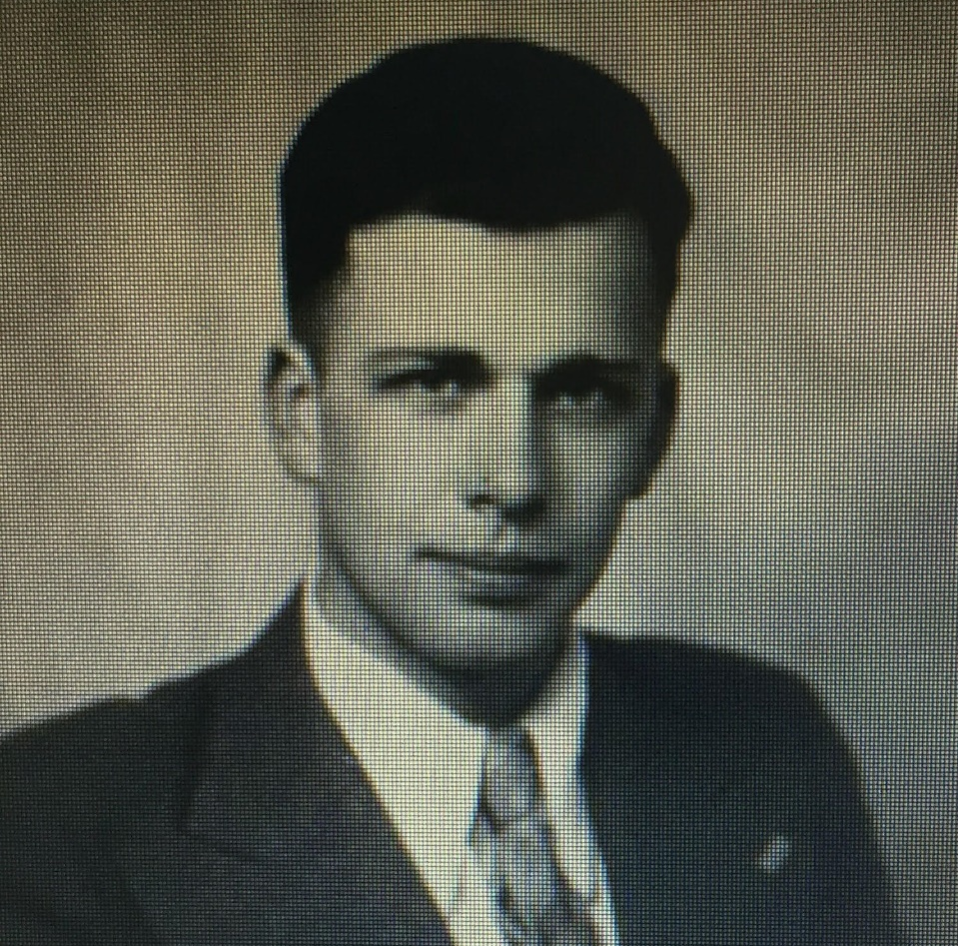
About TRIZ
TRIZ in its classical form was developed by the Soviet inventor Genrich Altshuller and his associates.
By 1969, Altshuller had reviewed about 40,000 patent abstracts in order to find out in what way the innovation had taken place and developed the concept of technical contradictions, the concept of ideality of a system, contradiction matrix, and 40 principles of invention
Notes:
TRIZ is not an insight. Altshuller reviewed plenty of patents and found some correlations between problems and solutions

Slide 9
Basic Principles
V1
V2
V3
Notes:
1. No way to create ideal system from scratch
2. We’re developing and reaching the perfect result?
3. What should we do to reach “the next step” to ideal final result?

Slide 10
Contradiction: SSO via SAML
Complexity
Security
Notes:
By reason of valuable functions we can’t get rid of this system.
We need to find out how to deal with harm and keep value.
TRIZ is about solving contradictions

Slide 11

High Level Algorithm
Concrete
Abstract
Concrete Problems
Concrete Solution
SSO via SAML
Abstract Contradictions
TRIZ tools
Invention Ideas
(+) Security / (-) Performance
Notes:
ARIZ contains 85 steps
Take V1, find contradiction, use tools to solve contradictions

Slide 12
Tools
40 Inventive Principles
Matrix of Contradictions
A suite of tips
Headers: Parameters of a system
Cells: Suitable Inventive Principles
Division
Asymmetry
Merging
Inversion
Another Dimension
…
(+) Security / (-) Complexity
Periodic Action
Self Service
Principle Replacement
Parameter Change
Notes:
We don’t have to review all ideas

Slide 13
Real-world example
Frontend: Search Page
Backend: Search API
Elasticsearch
Notes:
Code is not perfect enough

Slide 14
Contradiction #1: All tests are independent from Elasticsearch
Requirement: Text Search - Ignore 2 words in head and tail of a word
Search: nnecti
Find: Connection
Implementation: #TBD
How to test it?
Test if we specify this configuration
Reimplement Elasticsearch feature in mock
Notes:
Tests should reflect business requirements

Slide 15
Contradiction #1: All tests are independent from Elasticsearch
Easy to run these tests
Tests doesn’t track changes in Elasticsearch

Slide 16
Contradiction #2: Each entity has a representation on each level
Presentation Layer
Application Layer
Domain Layer
Data Access Layer
public class SearchRequestDto { public string Industry { get; set; } public int Headquarters { get; set; } public string Geography { get; set; } public decimal Revenue { get; set; } public decimal Income { get; set; } public decimal EBTDA { get; set; } public string Owner { get; set; } public string Partner { get; set; } public decimal IRR { get; set; } ... }
public class SearchRequestUseCase { public string Industry { get; set; } public int Headquarters { get; set; } public string Geography { get; set; } public decimal Revenue { get; set; } public decimal Income { get; set; } public decimal EBTDA { get; set; } public string Owner { get; set; } public string Partner { get; set; } public decimal IRR { get; set; } ... }
public class SearchRequestEntity { public string Industry { get; set; } public int Headquarters { get; set; } public string Geography { get; set; } public decimal Revenue { get; set; } public decimal Income { get; set; } public decimal EBTDA { get; set; } public string Owner { get; set; } public string Partner { get; set; } public decimal IRR { get; set; } ... }
public class SearchRequestDao { public string Industry { get; set; } public int Headquarters { get; set; } public string Geography { get; set; } public decimal Revenue { get; set; } public decimal Income { get; set; } public decimal EBTDA { get; set; } public string Owner { get; set; } public string Partner { get; set; } public decimal IRR { get; set; } ... }

Slide 17
Contradiction #2: Each entity has a representation on each level
Easy to deal with API changes
Have to write mappings and duplicate changes

Slide 18
Contradiction #3: Expose Nest library to Business Logic layer implicitly
Elasticsearch high-level library
Our application high level entity
public class TermQuery : FieldNameQueryBase, ITermQuery, IFieldNameQuery, IQuery { public object Value { get; set; } protected override bool Conditionless { get; } }
public class TermQueryEntity { public string Field { get; set; } public object Value { get; set; } public double? Boost { get; set; } public bool IsStrict { get; set; } public bool IsVerbatim { get; set; } public bool IsWritable { get; set; } public string Name { get; set; } }
public abstract class FieldNameQueryBase : QueryBase, IFieldNameQuery, IQuery { public Field Field { get; set; } }
bs => bs.Term( p => new TermQuery { Field = sq.Field, Value = sq.Value, Boost = sq.Boost, IsStrict = sq.IsStrict, IsVerbatim = sq.IsVerbatim, Name = sq.Name, }))
public abstract class QueryBase : IQuery { public double? Boost { get; set; } public bool IsStrict { get; set; } public bool IsVerbatim { get; set; } public bool IsWritable { get; } /// <inheritdoc /> public string Name { get; set; }

Slide 19
Contradiction #3: Expose Nest library to Business Logic layer implicitly
We can cover by tests all business cases
It’s hard to find business logic itself among boilerplate code

Slide 20
Real-world example: contradictions
All tests are independent from Elasticsearch
(+) Easy to run these tests: System Convenience
(-) Tests doesn’t track changes in Elasticsearch: External Risks
Each entity has a representation on each level
(+) Easy to deal with API changes: Adaptability
(-) Have to write mappings and duplicate changes: System Complexity
Expose Nest library to Business Logic layer implicitly
(+) We can cover by tests all business cases: System Reliability
(-) It’s hard to find business logic itself among boilerplate code: System Complexity

Slide 21
DEMO

Slide 22




Contradiction #1: Isolated Tests
#02 TAKING AWAY
#04 ASYMMETRY
#19 PERIODIC ACTION
#37 RELATIVE CHANGE

Slide 23
Contradiction #1: Isolated Tests
Unit Tests:
Given Limit 5 When Search Then 5 Rows
Given “Rev” When Search Then “Revenue”
Given Currency $ When Search Then 10$
#02 TAKING AWAY
Take away some tests to integration tests suite

Slide 24
Contradiction #1: Isolated Tests
Unit Tests:
Given Limit 5 When Search Then 5 Rows
Given “Rev” When Search Then “Revenue”
Given Currency $ When Search Then 10$
Integration Tests:
Given “Rev” When Search Then “Revenue”
Given Currency $ When Search Then 10$
#02 TAKING AWAY
Take away some tests to integration tests suite

Slide 25
Contradiction #1: Isolated Tests
Integration Tests
Unit Tests
??? Tests
200+ Tests
100% Branch Coverage
??? Coverage
#04 ASYMMETRY
Follow the test pyramid principle

Slide 26
Contradiction #1: Isolated Tests
Integration Tests
Unit Tests
20+ Tests
200+ Tests
100% Branch Coverage
100% Bugs and Corner cases Coverage
#04 ASYMMETRY
Follow the test pyramid principle

Slide 27
Contradiction #1: Isolated Tests
Elasticsearch
Build On Commit
Build On Commit
Build On Commit
#19 PERIODIC ACTION
Run these tests on the night rather than after each commit

Slide 28
Contradiction #1: Isolated Tests
Day
Unit Tests
Unit Tests
Night
Integration Tests
Integration Tests
Integration Tests
Unit Tests
#19 PERIODIC ACTION
Run these tests on the night rather than after each commit

Slide 29

Contradiction #1: Isolated Tests
Integration Tests
#37 RELATIVE CHANGE
Application
Use integration tests of another service to seed DB
Elasticsearch

Slide 30
Contradiction #1: Isolated Tests
Integration Tests
Integration Tests
#37 RELATIVE CHANGE
Another Application
Application
Use integration tests of another service to seed DB
Elasticsearch

Slide 31


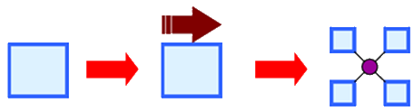

Contradiction #2: Entities Copy-Paste
#05 MERGING
#14 NON-LINEARITY
#15 DYNAMIZATION
#25 SELF-SERVICE

Slide 32
Contradiction #2: Entities Copy-Paste
Domain
Application
Presentation
SearchRequestEntity
DAL
SearchRequestUseCase
SearchRequestDao
SearchRequestDto
#05 MERGING
Merge all representation of an entity to the one

Slide 33
Contradiction #2: Entities Copy-Paste
Domain
Application
DAL
Presentation
#05 MERGING
Merge all representation of an entity to the one
public class SearchRequest

Slide 34
Contradiction #2: Entities Copy-Paste
public class SearchRequest { public SearchRequest(SearchRequestDto dto) { Industry = dto.Industry; Headquarters = dto.Headquarters; Geography = dto.Geography; Revenue = dto.Revenue; Income = dto.Income; EBTDA = dto.EBTDA; Owner = dto.Owner; InvestmentId = dto.InvestmentId; Partner = dto.Partner; IRR = dto.IRR; } public string Industry { get; } public int Headquarters { get; } public string Geography { get; } public decimal Revenue { get; } public decimal Income { get; } public decimal EBTDA { get; } public string Owner { get; } public int InvestmentId { get; } public string Partner { get; } public decimal IRR { get; } }
public class SearchRequest { public SearchRequest(string industry, int headquarters, string geography,
decimal revenue, decimal income, decimal ebtda, string owner, int investmentId,
string partner, decimal irr) { Industry = industry; Headquarters = headquarters; Geography = geography; Revenue = revenue; Income = income; EBTDA = ebtda; Owner = owner; InvestmentId = investmentId; Partner = partner; IRR = irr; } public string Industry { get; } public int Headquarters { get; } public string Geography { get; } public decimal Revenue { get; } public decimal Income { get; } public decimal EBTDA { get; } public string Owner { get; } public int InvestmentId { get; } public string Partner { get; } public decimal IRR { get; } }
Notes:
No way to deserialize json to this entitiy

Slide 35
Contradiction #2: Entities Copy-Paste
public class SearchRequest { public SearchRequest(SearchRequestDto dto) { Industry = dto.Industry; Headquarters = dto.Headquarters; Geography = dto.Geography; Revenue = dto.Revenue; Income = dto.Income; EBTDA = dto.EBTDA; Owner = dto.Owner; InvestmentId = dto.InvestmentId; Partner = dto.Partner; IRR = dto.IRR; } public string Industry { get; } public int Headquarters { get; } public string Geography { get; } public decimal Revenue { get; } public decimal Income { get; } public decimal EBTDA { get; } public string Owner { get; } public int InvestmentId { get; } public string Partner { get; } public decimal IRR { get; } }
#14 NON-LINEARITY
High level entity should be interface than class
Notes:
Stop thinking about properties assignment

Slide 36
Contradiction #2: Entities Copy-Paste
public interface ISearchRequest { public string Industry { get; } public int Headquarters { get; } public string Geography { get; } public decimal Revenue { get; } public decimal Income { get; } public decimal EBTDA { get; } public string Owner { get; } public int InvestmentId { get; } public string Partner { get; } public decimal IRR { get; } }
#14 NON-LINEARITY
High level entity should be interface than class
Notes:
Stop thinking about properties assignment

Slide 37
Contradiction #2: Entities Copy-Paste
public interface ISearchRequest { public string Industry { get; } public int Headquarters { get; } public string Geography { get; } public decimal Revenue { get; } public decimal Income { get; } public decimal EBTDA { get; } public string Owner { get; } public int InvestmentId { get; } public string Partner { get; } public decimal IRR { get; } }
public class SearchRequestDto : ISearchRequest { public string Industry { get; set; } public int Headquarters { get; set; } public string Geography { get; set; } public decimal Revenue { get; set; } public decimal Income { get; set; } public decimal EBTDA { get; set; } public string Owner { get; set; } public int InvestmentId { get; set; } public string Partner { get; set; } public decimal IRR { get; set; } }
Notes:
Instead of mapping we use interface implementation

Slide 38
Contradiction #2: Entities Copy-Paste
public class SearchFinanceRequest { public decimal Revenue { get; set; } public decimal Income { get; set; } public decimal EBTDA { get; set; } } public class SearchInvestmentRequest { public int InvestmentId { get; set; } public string Partner { get; set; } public decimal IRR { get; set; } }
public class SearchRequestDto : ISearchRequest { public string Industry { get; set; } public int Headquarters { get; set; } public string Geography { get; set; } public decimal Revenue { get; set; } public decimal Income { get; set; } public decimal EBTDA { get; set; } public string Owner { get; set; } public int InvestmentId { get; set; } public string Partner { get; set; } public decimal IRR { get; set; } }

Slide 39
Contradiction #2: Entities Copy-Paste
public class SearchFinanceRequest { public decimal Revenue { get; set; } public decimal Income { get; set; } public decimal EBTDA { get; set; } } public class SearchInvestmentRequest { public int InvestmentId { get; set; } public string Partner { get; set; } public decimal IRR { get; set; } }
interface ISearchBuilder { void SearchFinance(SearchFinanceRequest r); void SearchInvestment(SearchInvestmentRequest r); }
void Search(ISearchBuilder searchBuilder,
IMapper mapper, SearchRequestDto request) { searchBuilder.SearchFinance(
mapper.Map<SearchFinanceRequest>(request)); searchBuilder.SearchInvestment(
mapper.Map<SearchInvestmentRequest>(request)); }
Notes:
But we are trying to keep one class

Slide 40
Contradiction #2: Entities Copy-Paste
public class SearchFinanceRequest { public decimal Revenue { get; set; } public decimal Income { get; set; } public decimal EBTDA { get; set; } } public class SearchInvestmentRequest { public int InvestmentId { get; set; } public string Partner { get; set; } public decimal IRR { get; set; } }
#15 DYNAMIZATION
Specify in a parameter type a required interface
Notes:
Making something automatic

Slide 41
Contradiction #2: Entities Copy-Paste
public interface ISearchFinanceRequest { public decimal Revenue { get; set; } public decimal Income { get; set; } public decimal EBTDA { get; set; } } public interface ISearchInvestmentRequest { public int InvestmentId { get; set; } public string Partner { get; set; } public decimal IRR { get; set; } }
#15 DYNAMIZATION
Specify in a parameter type a required interface
Notes:
Making something automatic. Avoid extra work

Slide 42
Contradiction #2: Entities Copy-Paste
public class SearchRequestDto : ISearchRequest, ISearchFinanceRequest, ISearchInvestmentRequest { public string Industry { get; set; } public int Headquarters { get; set; } public string Geography { get; set; } public decimal Revenue { get; set; } public decimal Income { get; set; } public decimal EBTDA { get; set; } public string Owner { get; set; } public int InvestmentId { get; set; } public string Partner { get; set; } public decimal IRR { get; set; } }
public interface ISearchFinanceRequest { public decimal Revenue { get; set; } public decimal Income { get; set; } public decimal EBTDA { get; set; } } public interface ISearchInvestmentRequest { public int InvestmentId { get; set; } public string Partner { get; set; } public decimal IRR { get; set; } }

Slide 43
Contradiction #2: Entities Copy-Paste
interface ISearchBuilder { void SearchFinance(ISearchFinanceRequest r); void SearchInvestment(ISearchInvestmentRequest r); }
public class SearchRequestDto : ISearchRequest, ISearchFinanceRequest, ISearchInvestmentRequest { public string Industry { get; set; } public int Headquarters { get; set; } public string Geography { get; set; } public decimal Revenue { get; set; } public decimal Income { get; set; } public decimal EBTDA { get; set; } public string Owner { get; set; } public int InvestmentId { get; set; } public string Partner { get; set; } public decimal IRR { get; set; } }
void Search(ISearchBuilder searchBuilder, SearchRequestDto request) { searchBuilder.SearchFinance(request); searchBuilder.SearchInvestment(request); }
Notes:
We’re avoiding extra mappings

Slide 44
Contradiction #2: Entities Copy-Paste
class SearchRefinementsDto { public List<RefinementDto> Refinements { get; set; } } class RefinementDto { public string Name { get; set; } public int Amount { get; set; } }
interface ISearchRefinements { IReadOnlyList<IRefinement> Refinements { get; } } interface IRefinement { string Name { get; } int Amount { get; } }
Notes:
How to deal with mismatches between dto and our entity representation?

Slide 45
Contradiction #2: Entities Copy-Paste
class SearchRefinementsDto:
ISearchRefinements { public List<RefinementDto> Refinements { get; set; } } class RefinementDto: IRefinement { public string Name { get; set; } public int Amount { get; set; } }
interface ISearchRefinements { IReadOnlyList<IRefinement> Refinements { get; } } interface IRefinement { string Name { get; } int Amount { get; } }
Property 'Refinements' cannot implement
property from interface 'ISearchRefinements'
Notes:
How to deal with details in Dto that shouldn’t be revealed in Entity?

Slide 46
Contradiction #2: Entities Copy-Paste
class SearchRefinementsDto:
ISearchRefinements { public List<RefinementDto> Refinements { get; set; } } class RefinementDto: IRefinement { public string Name { get; set; } public int Amount { get; set; } }
#25 SELF-SERVICE
Property 'Refinements' cannot implement
property from interface 'ISearchRefinements'
Classes that implement interface solves mismatches on its own
Notes:
How to deal with details in Dto that shouldn’t be revealed in Entity?

Slide 47
Contradiction #2: Entities Copy-Paste
class SearchRefinementsDto: ISearchRefinements { public List<RefinementDto> Refinements { get; set; } IReadOnlyList<IRefinement> ISearchRefinements.Refinements => Refinements; }
Notes:
How to deal with details in Dto that shouldn’t be revealed in Entity?

Slide 48
How to find contradictions?

Slide 49
Root Conflict Analysis
Found bugs on production after Elasticsearch update
Easy to run these tests
Tests doesn’t track changes in Elasticsearch
All tests are independent from Elasticsearch
Notes:
Can we get rid of tests?

Slide 50
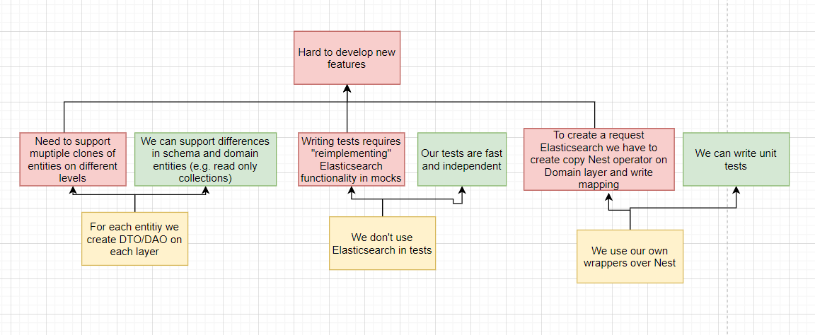
Example #TBD: polish

Slide 51
Root Conflict Analysis Algorithm
Identify the problem
Answer: why it happens?
Does this thing provide value to the system?
Yes: We found a contradiction!
No: GOTO #2

Slide 52
Conclusion
#TBD

Slide 53
Materials
#TBD
Expose materials from EPAM?
#TBD: reference to github
Altshuller book

Slide 54
Contradiction #1: Isolated Tests
#02 TAKING AWAY
Take away some tests to integration tests suite
Unit Tests:
Given Limit 5 When Search Then 5 Rows
Given “Rev” When Search Then “Revenue”
Given Currency $ When Search Then 10$
…

Slide 55
Contradiction #1: Isolated Tests
#02 TAKING AWAY
Take away some tests to integration tests suite
Unit Tests:
Given Limit 5 When Search Then 5 Rows
Given “Rev” When Search Then “Revenue”
Given Currency $ When Search Then 10$
…
Integration Tests:
Given “Rev” When Search Then “Revenue”
Given Currency $ When Search Then 10$
…

Slide 56
All tests are independent from Elasticsearch
#02 TAKING AWAY
#04 ASYMMETRY
Take away some tests to integration tests suite
Follow the test pyramid principle
Run these tests on the night rather than after each commit
Use integration tests of another service to seed DB
#19 PERIODIC ACTION
#37 RELATIVE CHANGE

